Slide 1
Elucidating cause and effect in bacteria-induced colorectal cancer in the context of host inflammation.
Anthony Fodor
Associate Professor
Bioinformatics and Genomics
UNC Charlotte

Slide 2
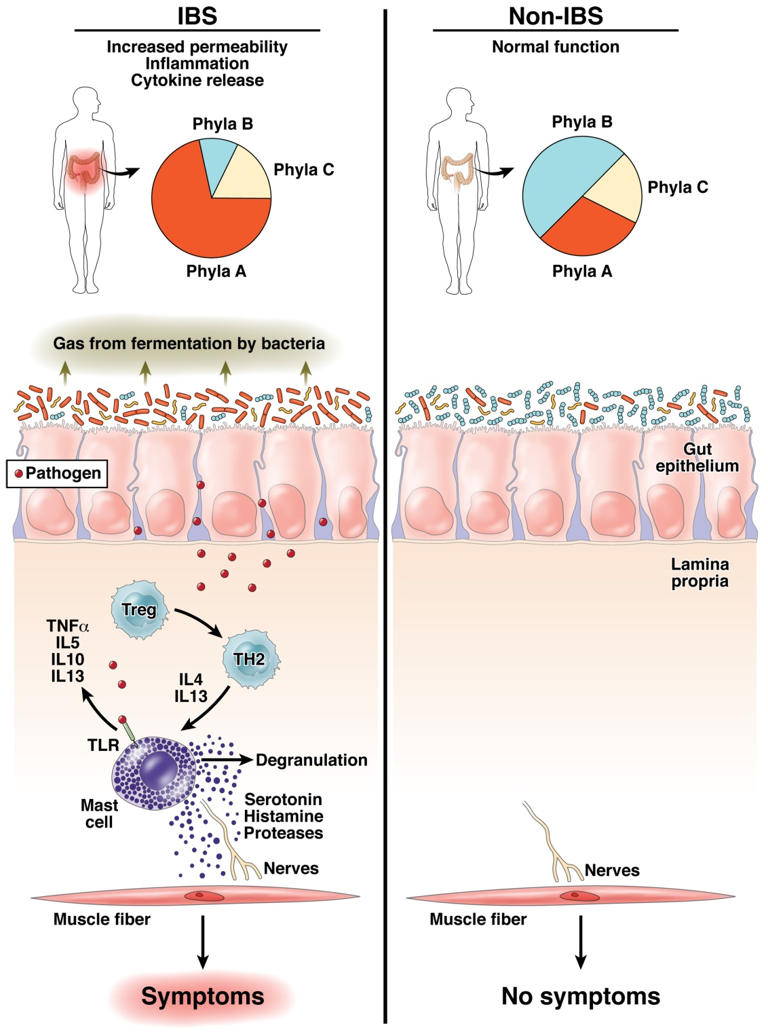
The “dysbiosis” hypothesis linking risk for inflammation related diseases to the microbiome
Fodor & Talley. Gastroenterology. 2011

Slide 3
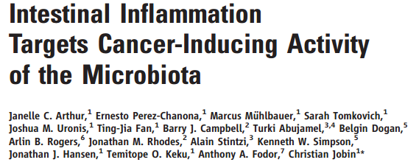
2012

Slide 4
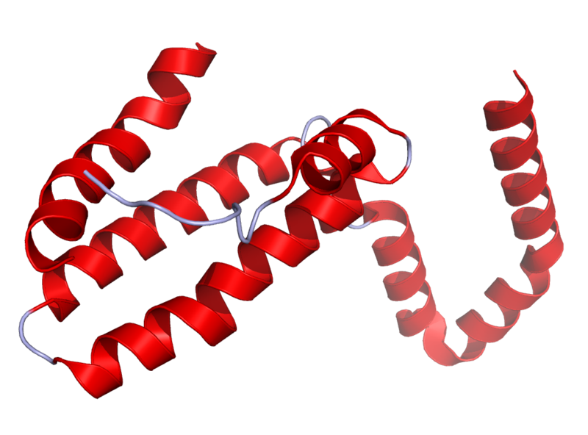
Il10^{-\-} Mouse Model
Il10 is an anti-inflammatory cytokine.
Inhibits pro inflammatory cytokines
Acts as an immunoregulator in the GI tract.
Lamblin, C., et al.,The Journal of allergy and clinical immunology, 2001.
http://en.wikipedia.org/wiki/Interleukin_10
Il10-\-
Il10^{-\-} mice are prone to inflammation with commensal tolerated by WT mice.
Knoch, B., et al.,Microbiology-Sgm, 2010
Established model for investigating disease phenotypes associated with inflammation

Slide 5
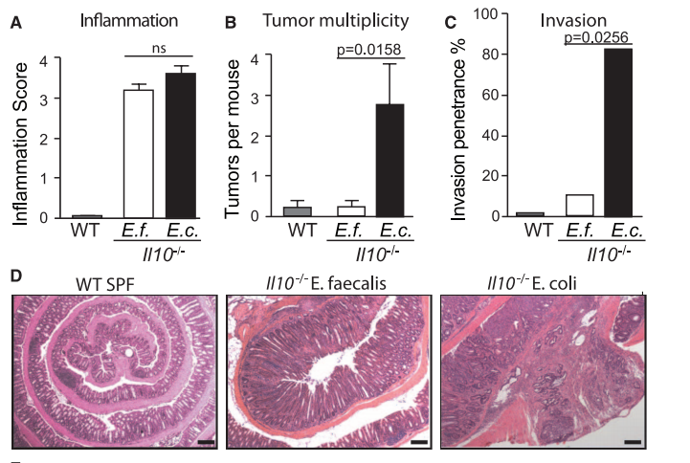
Some bugs, but not others, can cause inflammation to progress to cancer…
2012
Arthur et al, Science, 2012

Slide 6
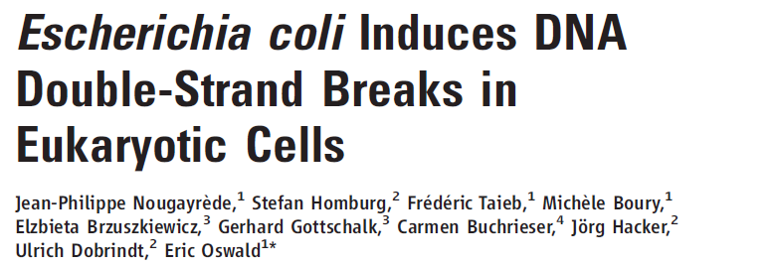
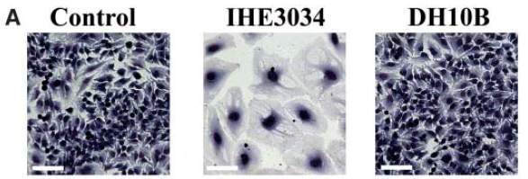
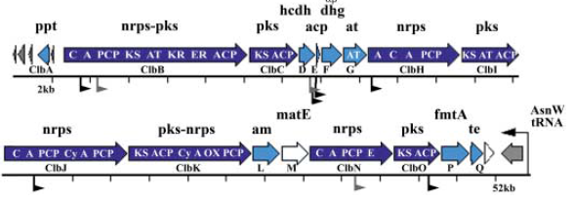
2006
Clinical E. coli isolates
change cell morphology
This activity is dependent
on the PKS island,
that encodes machinery
for polyketide and
non-ribosomal polypeptide
synthesis

Slide 7
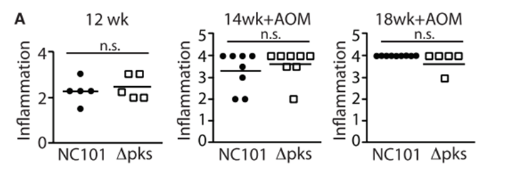
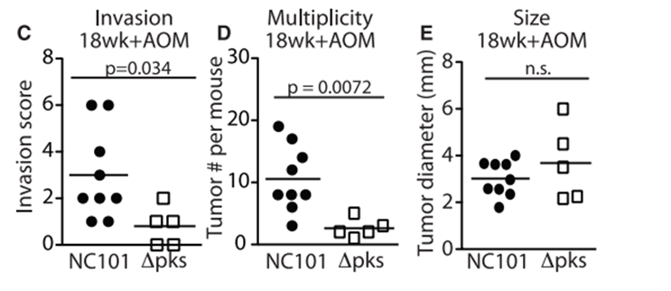
Remarkably, the PKS island appears essential in promoting progress to CRC
2006
2012

Slide 8
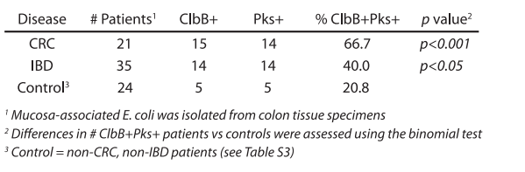
The presence of PKS is associated with cancers in multiple human cohorts
2006
2012

Slide 9
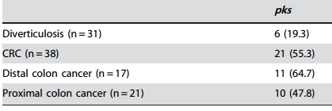
The presence of PKS is associated with cancers in multiple human cohorts
2006
2012
Buc et al - High Prevalence of Mucosa-Associated E. coli Producing
Cyclomodulin and Genotoxin in Colon Cancer (2013)
2013

Slide 10
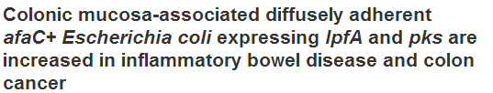
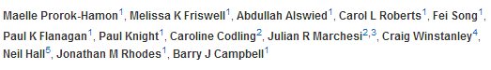
The presence of PKS is associated with cancers in multiple human cohorts
2006
2012
Buc et al - High Prevalence of Mucosa-Associated E. coli Producing
Cyclomodulin and Genotoxin in Colon Cancer (2013)
2013

Slide 11
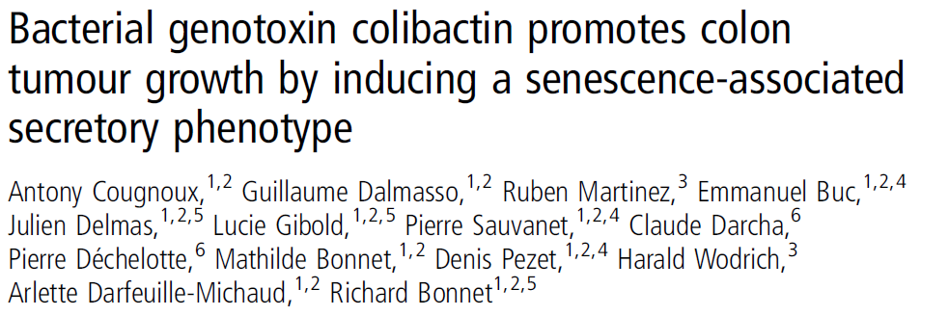
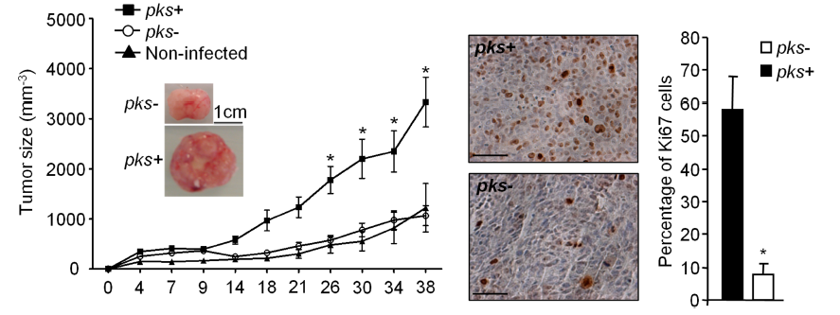
This oncogenic potential of PKS appears to be reproducible
in a HCT116 cell/ nude mouse system
2006
2012
2013
2014

Slide 12
2006
2012
Why does E. coli/pks infect some
people but not others?
How does the host environment impact the presence of E. coli?
How does the host environment
impact the effect of E. coli?
2013
2014

Slide 13
How does the microbiome change over time in WT and inflamed animals?
6 WT cages
24 mice
5 Il10^{-\-} cages
17 mice
Illumina 16 V6 paired end sequencing of fecal samples.
Collected at 2, 12 and 20 weeks.
2x coverage by merging reads.
Clustered into OTUs
Bray-Curtis distances
PcOA (Mothur)
Mapped via blast to Silva database
Taxonomy assignment (RDP)
Arthur et al.; in revision

Slide 14
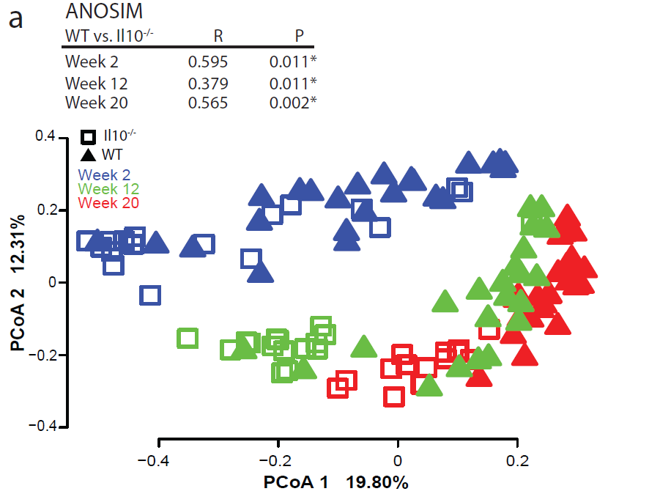
Time and inflammation are essential elements in structuring the microbial community
Arthur et al.; in revision

Slide 15
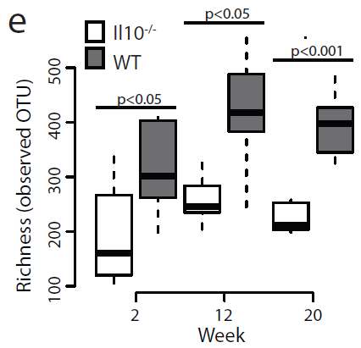
Inflammation interferes with normal succession…
Arthur et al.; in revision

Slide 16
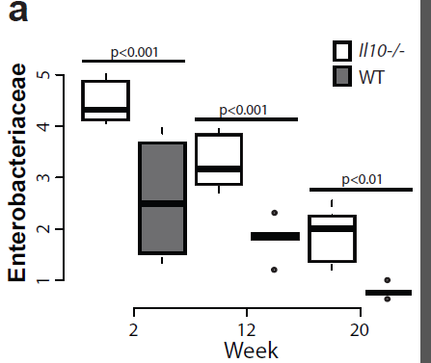
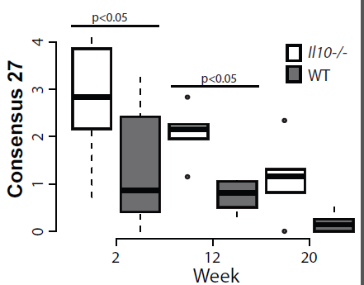
E. coli is selected against over time, but is always higher in inflamed animals

Slide 17
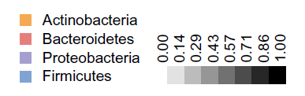
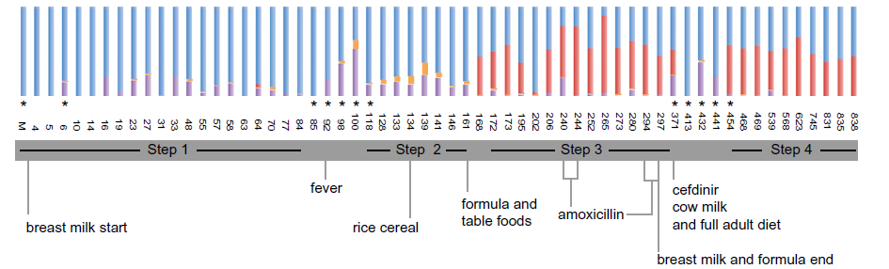
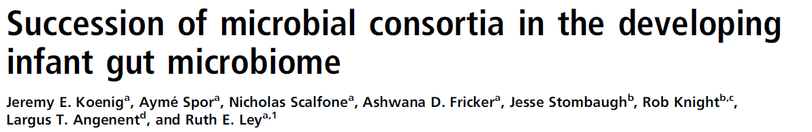
Proteobacteria selected against over time can be seen in human samples as well

Slide 18
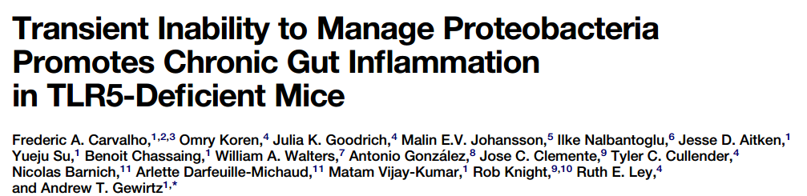
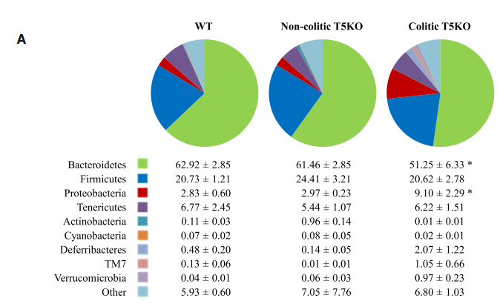
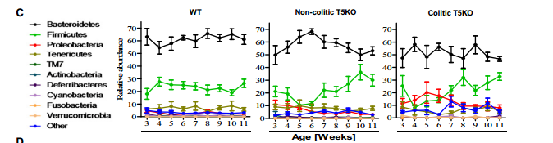
Inflammation interfering with normal succession is an emergent theme in the literature..

Slide 19
Taken together, these data suggest a simple model linking cancer to E. coli/pks
Interferes with
selection against
Inflammation
E. Coli/pks
“Invade” the gut
during stress/birth
Damages host DNA
Proteobacteria in
the external enviroment
Cancer
Arthur et al.; in revision

Slide 20
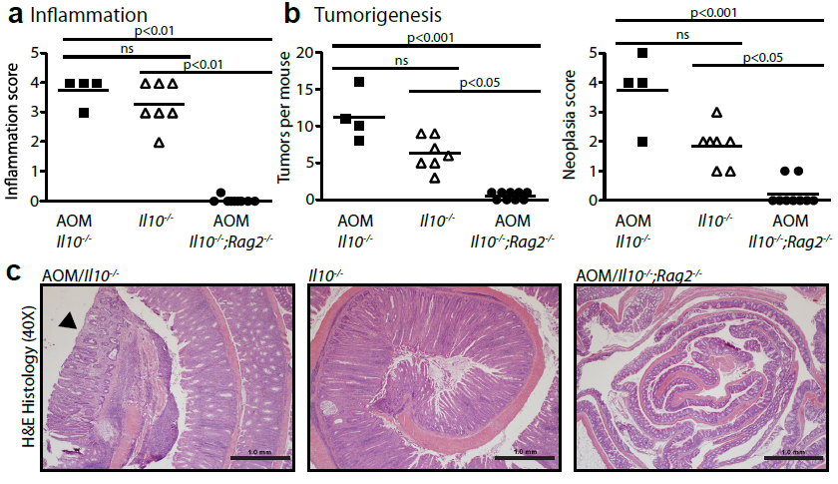
But Inflammation is essential for cancer progression
Arthur et al.; in revision

Slide 21
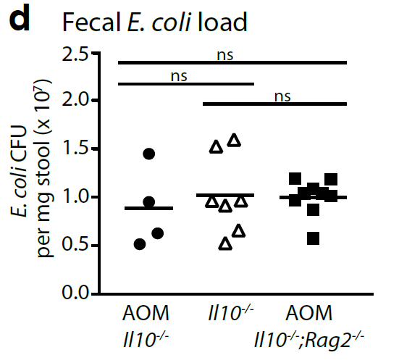
The lack of cancer is not caused by a failure of inoculation by PKS/E. coli
Arthur et al.; in revision

Slide 22
So this model is too simple….
Interferes with
selection against
Inflammation
E. coli/pks
“Invade” the gut
during stress/birth
Damages host DNA
Proteobacteria in
the external enviroment
Cancer

Slide 23
Inflammation is a co-requisite for cancer development in the IL10-/- model
Interferes with
selection against
Inflammation
E. coli/pks
“Invade” the gut
during stress/birth
Damages host DNA
Proteobacteria in
the external enviroment
Cancer

Slide 24
Inflammation is a co-requisite for cancer development in the IL10-/- model
But is this by a direct effect on the host cell?
Interferes with
selection against
Inflammation
E. coli/pks
“Invade” the gut
during stress/birth
Stresses host cells
Damages host DNA
Proteobacteria in
the external enviroment
Cancer

Slide 25
Inflammation is a co-requisite for cancer development in the IL10-/- model
Or is inflammation required to activate E. Coli/pks?
Interferes with
selection against
Inflammation
E. coli/pks
“activates” pks
“Invade” the gut
during stress/birth
Damages host DNA
Proteobacteria in
the external enviroment
Cancer

Slide 26
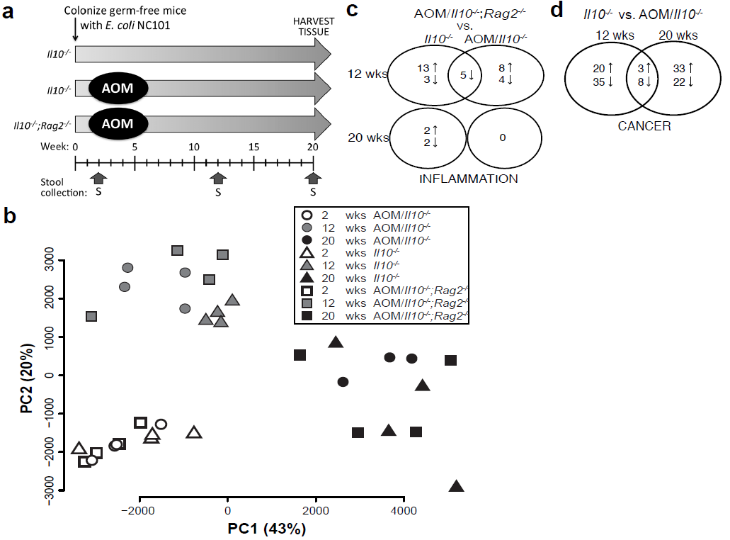
Time, not clinical symptoms, structures the E. coli transcriptome….
no inflammation
vs. inflammation

Slide 27
So this model seems unlikely….
Interferes with
selection against
Inflammation
E. coli/pks
“activates” pks
“Invade” the gut
during stress/birth
Damages host DNA
Proteobacteria in
the external enviroment
Cancer

Slide 28
Remarkably, there are more transcripts associated with cancer than inflammation
cancer vs. non-cancer

Slide 29
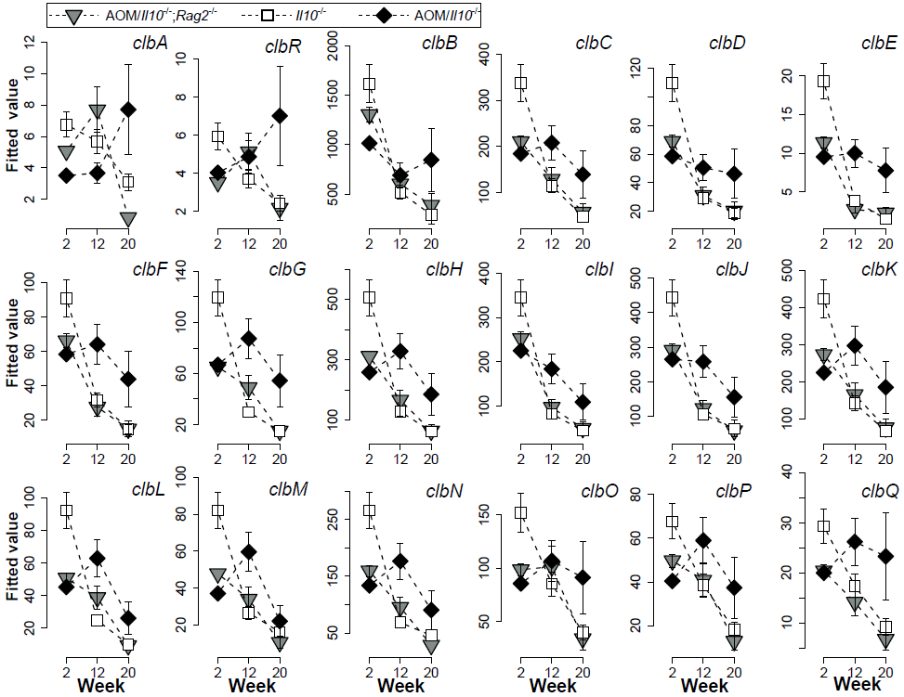
At the twelve week time period for IL10-/-, genes on the pks island are higher in AOM treatment
v

Slide 30
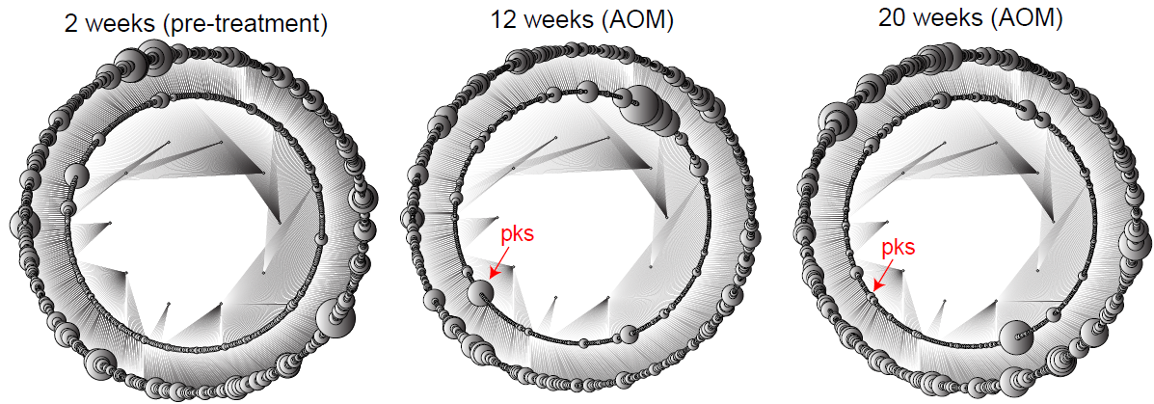
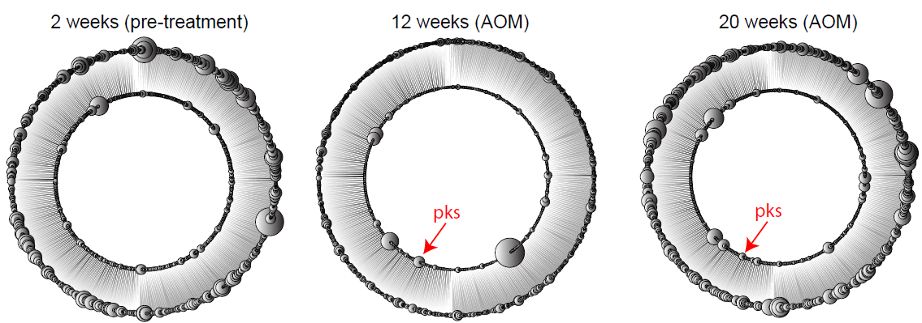
Gene expression of the pks island is linked to the development of cancer before the
cancer is developed!
IL10-/- vs. IL10-/- AOM
A
B
Figure 4-3: Operon-based differential expression analysis reveals that the pks island is upregulated in the cancer microenvironment at 12 weeks. For each predicted operon for each of the 10 contigs (shown in inner ring) in the NC101 genome (A) and each predicted operon of E. coli 536 (B), we evaluated a null hypothesis of no differential expression between Il10^{-/-} and AOM/Il10^{-/-} at each time point. P-values for this null hypothesis for each operon (second ring) were generated via the GAGE algorithm (see methods and supplemental data 6). At 2 weeks (left panel), animals had not yet been exposed to AOM and the calculated P-value for pks was 0.9999 in both A and B. At the 12 week time-point, the pks island had a P-value of 3.4x10⁻⁵ (A) and 1.82x10⁻⁵ (B), the 5th most differentially expressed operon in the E. coli NC101 and E. coli 536 genomes. At the 20 week time-point, the pks island had a P-value of 0.09 (A) and 0.035 (B) and was the 19th (A) and the 12th (B) most differentially expressed operon. Sizes of all circles reflect uncorrected P-values on a log scale. In determining P-values, only the 3 animals for which we had RNA-seq data for all 3 time-points were used.

Slide 31
As far as we can push the chain of causality with our current data
Interferes with
selection against
Inflammation
E. coli/pks
Interaction feedback loop?
Damaged cells activate PKS?
“Invade” the gut
during stress/birth
Stresses host cells
Proteobacteria in
the external enviroment
Cancer

Slide 32
The overall model of gut dysbiosis is
rapidly gaining support…
Fodor & Talley. Gastroenterology. 2011

Slide 33






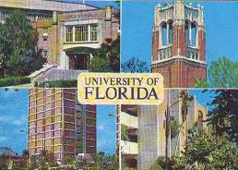


Acknowledgements
UNC-Chapel Hill
Janelle Arthur
Marcus Muhlbauer
UNC-Charlotte
Ra’ad Gharaibeh
Jon McCafferty
UF- Gainesville
Christian Jobin
Raad Gharaibeh
Jon McCafferty
Marcus Muhlbauer
Janelle Arthur
Christian Jobin

Slide 38
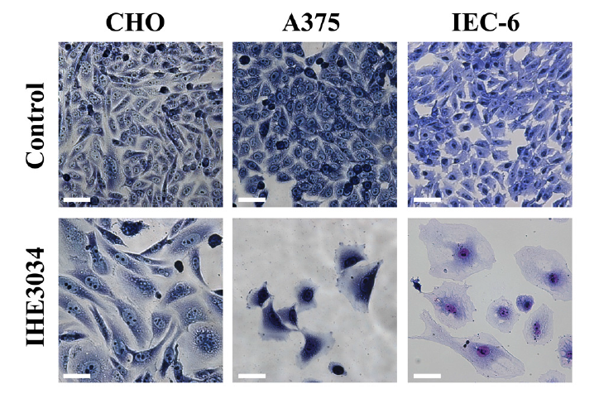
The effects of the PKS island can be seen across a wide range of cell types
2006
(human melanoma)
non-tumor rat intestinal crypt
PKS seems to have some relationship to human epidemiology.
It is present in intestinal pathogenic E. coli strains and extraintestinal
pathogenic E. coli (ExPEC) strains but absent from healthy individuals

Slide 39
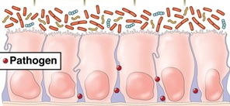
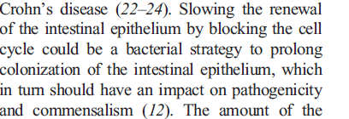
Perhaps E. Coli benefits from inhibiting the cell cycle
damaging the host in the process….
2006

Slide 40
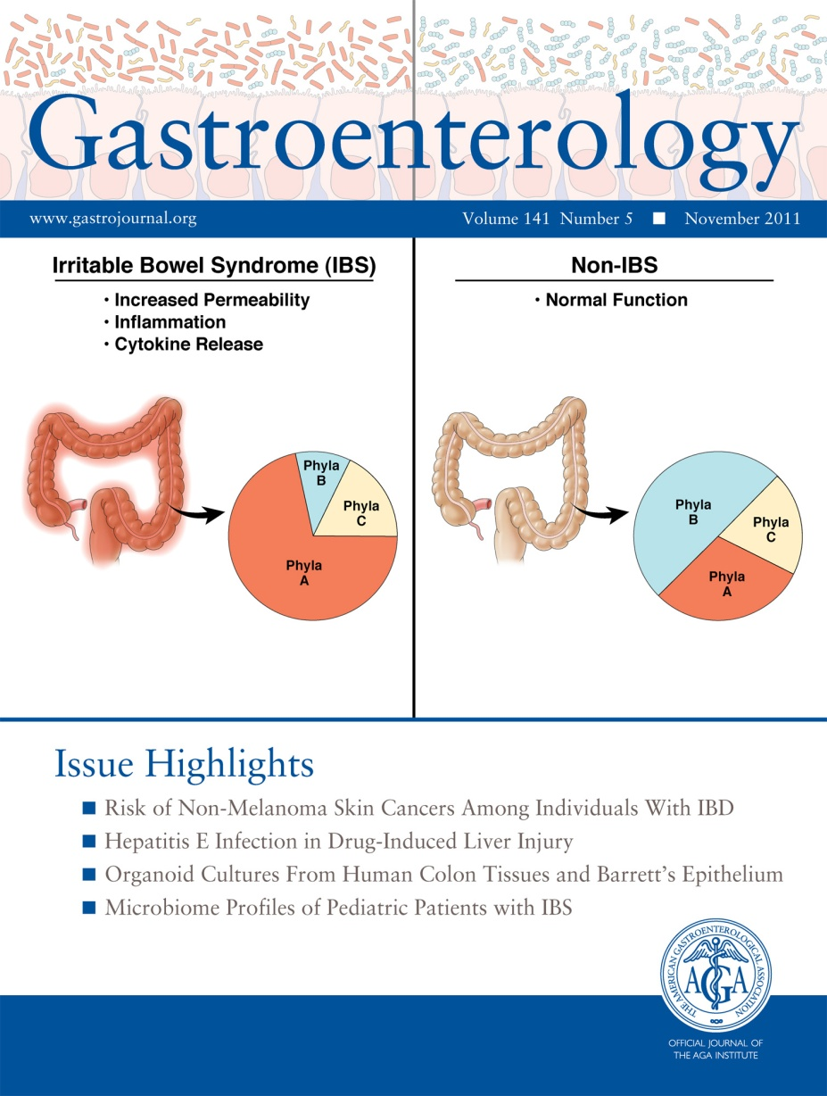
But does this damage relate to inflammation?
Fodor & Talley. Gastroenterology. 2011

Slide 41
Early Proteobacteria expansion shifts to more gut like over time
*80% RDP classification threshold
Arthur et al.; in revision

Slide 42
RNA-seq: edgeR – explicitly modeling mean/variance relationships allowing
for over-dispersion
Microbiome: Bray-Curtis dis-similarity on relative abundance counts from
denovo OTU pipeline

Slide 43
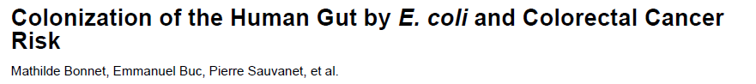
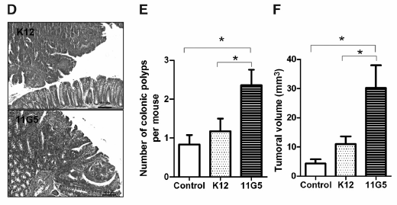
A clinical strain containing pks promotes colonic polyp formation in the min mouse model
2006
2012
2013

